Slide 1
Jaundice-HBV Test Kit

Slide 2
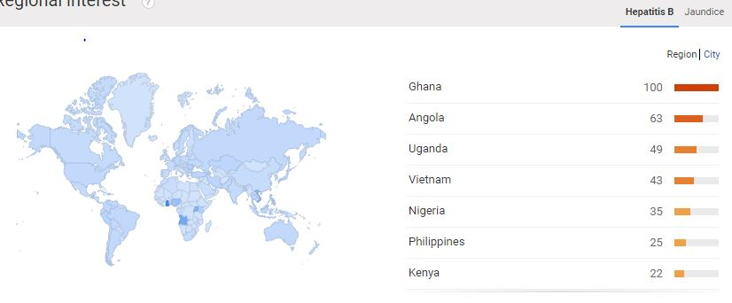
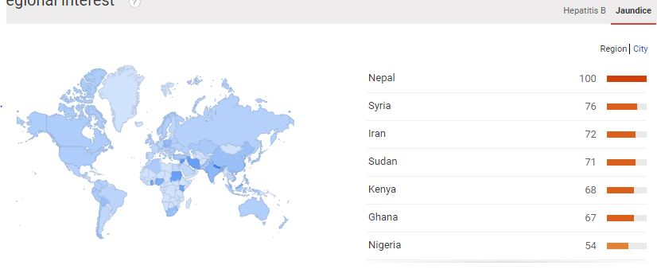
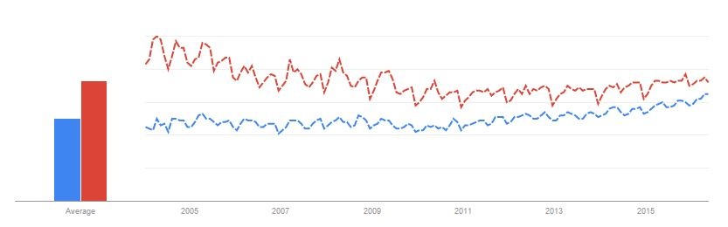
Survey

Slide 3
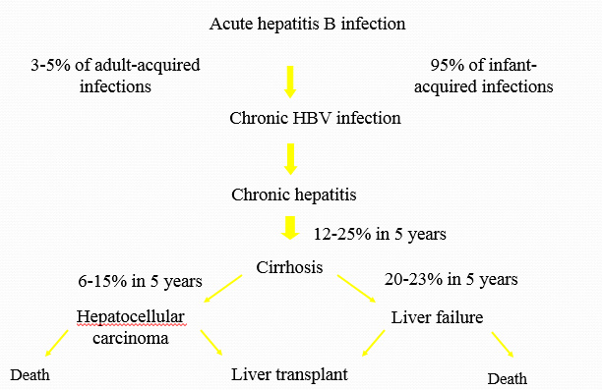
Hepatitis B Virus and Causes
Notes:
In highly endemic areas, hepatitis B is most commonly spread from mother to child at birth (perinatal transmission), or through horizontal transmission (exposure to infected blood), especially from an infected child to an uninfected child during the first 5 years of life. The development of chronic infection is very common in infants infected from their mothers or before the age of 5 years.

Slide 4

Jaundice and Causes

Slide 5
When the Test can be used?
When the eye turns yellow
When urine turns yellow and more concentrated.
When the individual is affected by Jaundice.
When the individual is suffering from malfunctioning of liver
When the individual got affected by any of the disease like Malaria, Sickle cell disease,Hereditary spherocytosis,Thalassemia,Glucose-6-phosphate dehydrogenase deficiency (G6PD)

Slide 6
Sample used in Test
The sample that going to be used in this Test kit is Urine.
For detecting HbSAg and Bilirubin, Urine is used as an analyte for checking Jaundice and Hepatitis B.
HbSAg | Bilurubin
Present or not | 0 to 25 mg/dL.

Slide 7
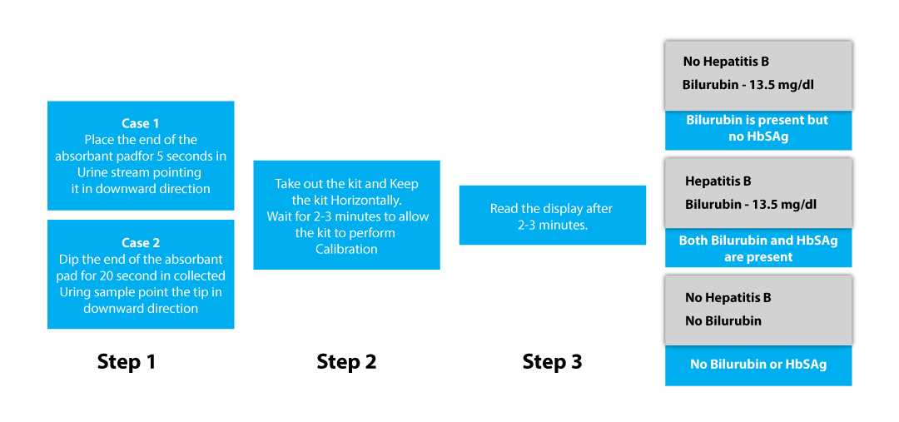
Test Procedure

Slide 8
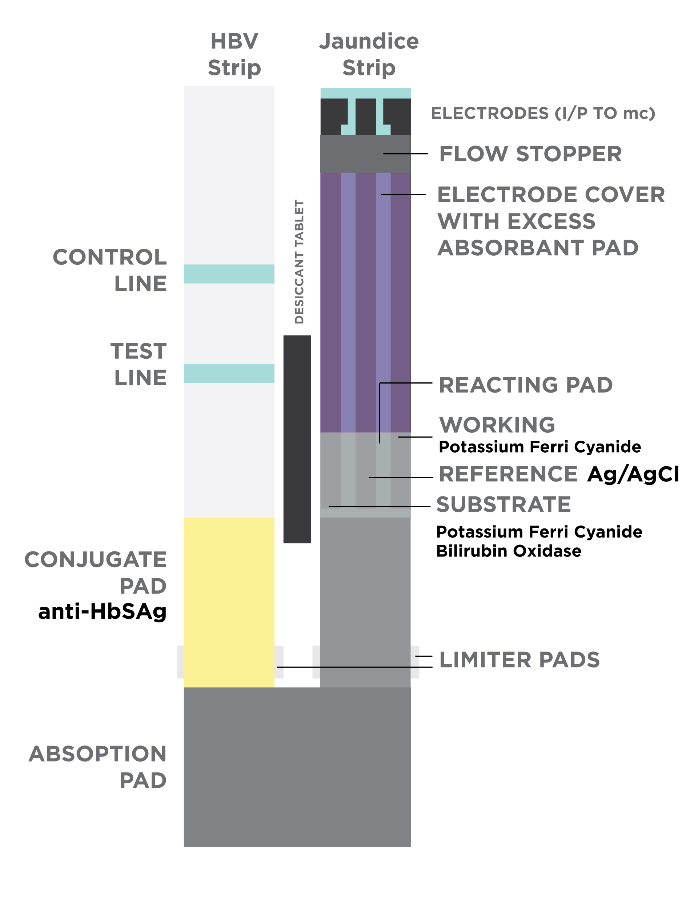
Block Diagram
Section | HBV Strip | Jaundice Strip
Sample Handling | Absorption Pad | Absorption Pad
Capture Layer | Conjugate Pad | Reacting Pad
Transducer | Test Line-shows result in optical form | Electrodes- Current obtained through electrochemical reaction
Signal Detection | Color change detected by photodiode | Voltage change detected by potentiometers

Slide 9
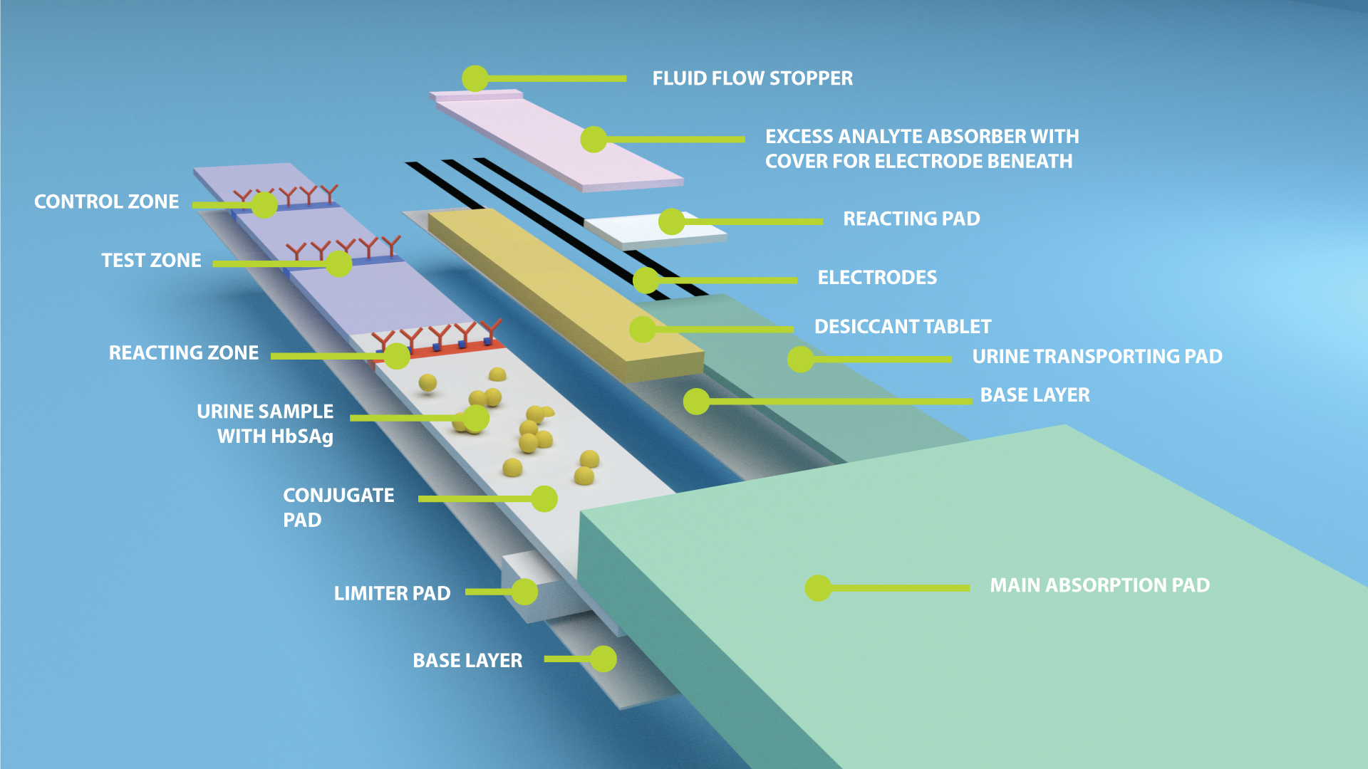

Slide 10
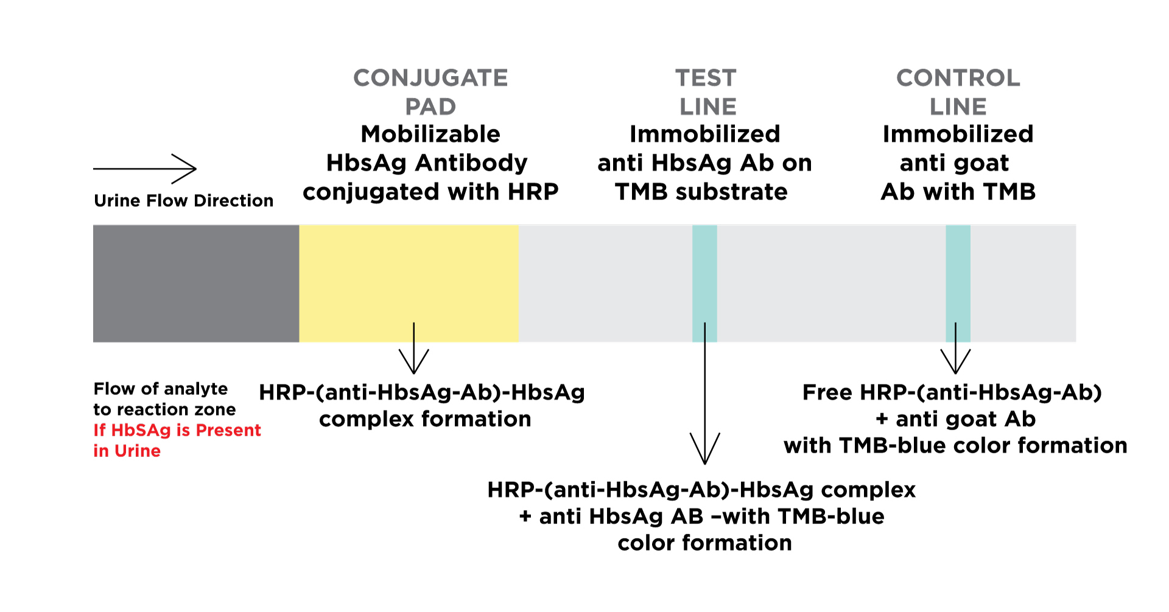
HBV Strip

Slide 11
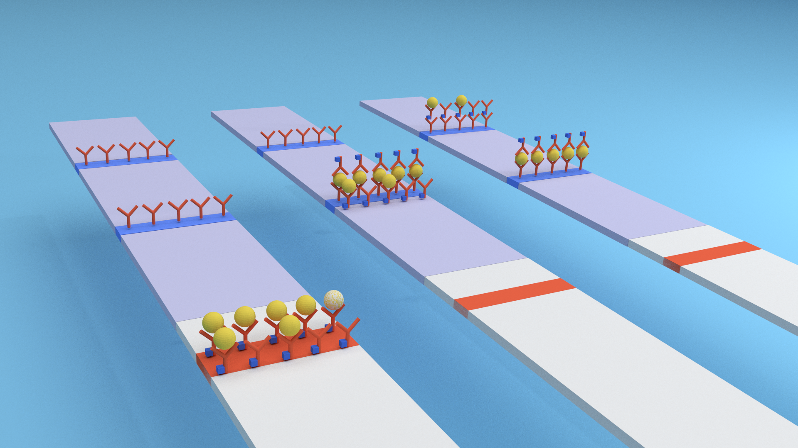

Slide 12
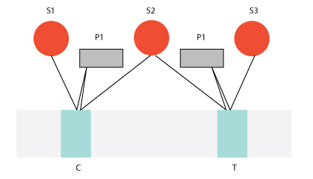
Signal Detection and processor
HBV Strip: Using Optical method
The device housing comprises an analytical assembly labelled (10), which comprises as circuit board (12) supporting two LEDs and two photodiodes (14), aligned with a test zone of a nitrocellulose strip lateral flow strip (16) which is in liquid flow communication with the sampling portion (4) of the liquid transport or carrier. The test zone is the zone in which a labelled reagent accumulates in the presence (or absence, as appropriate) of the analyte of interest. This accumulation affects the optical property of the test strip (16), such as its reflectivity or transmissivity, a property that can be measured by the LED/photodiode arrangement. The arrangement produces an output current, the magnitude of which is related to the amount of label accumulated in the test zone.

Slide 13
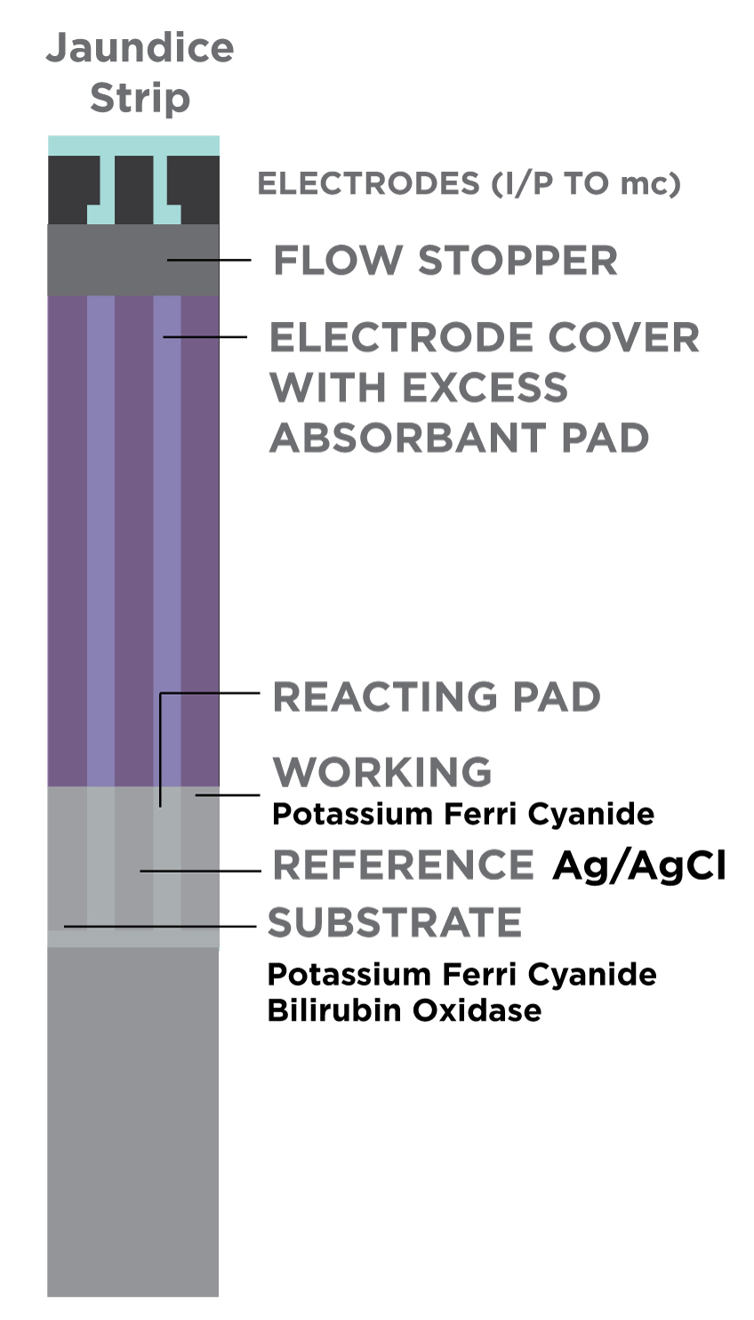
Jaundice Strip
Working electrode - loaded with oxidizing reagent potassium ferri cyanide
substrate electrode - loaded with same oxidizing reagent along with chemical reagent(bilirubin oxidase) that consumes bilirubin before being oxidized by the mediator
Reference elctrode may be loaded with Ag/Agcl.

Slide 14
Signal Detection
Bilirubin + 2K₃[Fe(CN)₆] +H₂O Biliverdin + 2K₄[Fe(CN)₆]
2Fe(CN)₆⁴⁻ 2Fe(CN)₆³⁻ + 2e⁻
2Fe(CN)₆³⁻ + 2e⁻ 2Fe(CN)₆⁴⁻
Bilurubin oxidase
anode
cathode

Slide 15
Calibration
Jaundice Strip: Using electrochemical reaction.

Slide 16
Calibration
result = [(rear photodiode current value/rear photodiode initial value) - (front photodiode current value/front photodiode initial value)]
* scaling factor.

Slide 17
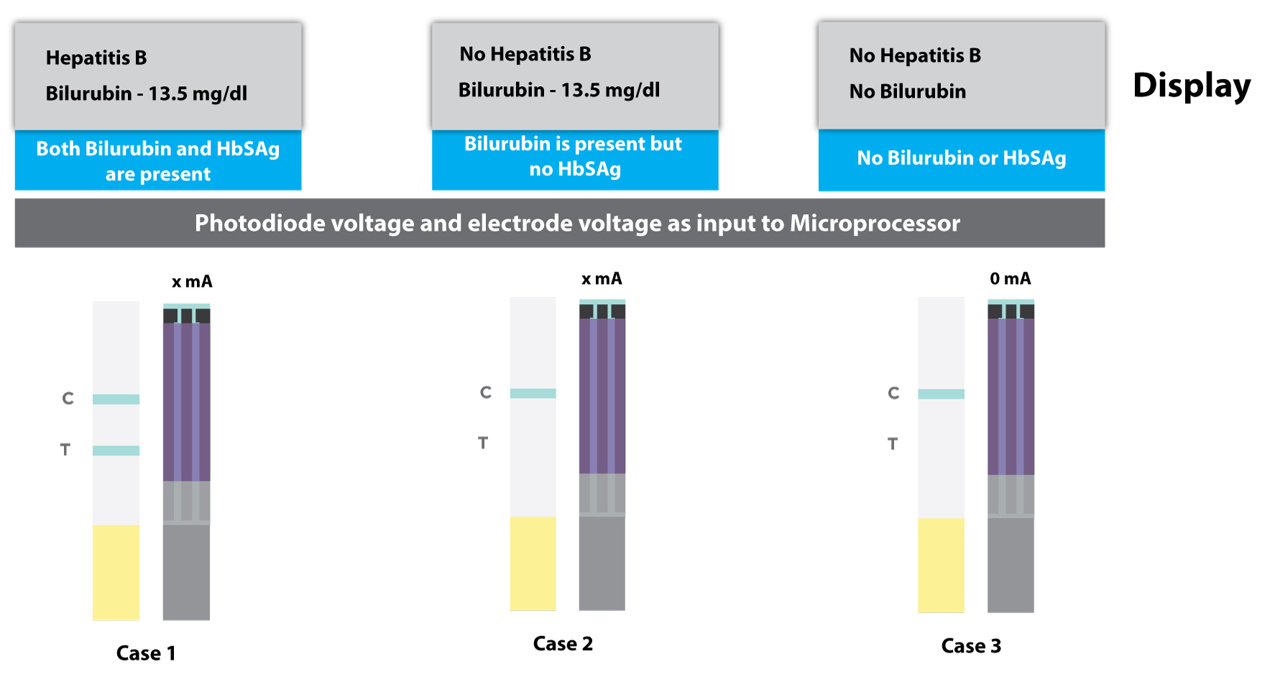
Signal Detection and processor

Slide 18
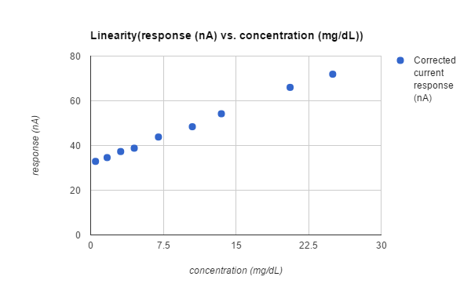

Slide 19
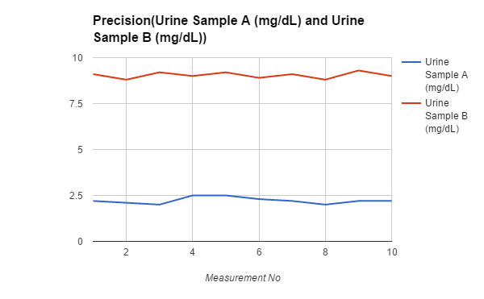

Slide 20
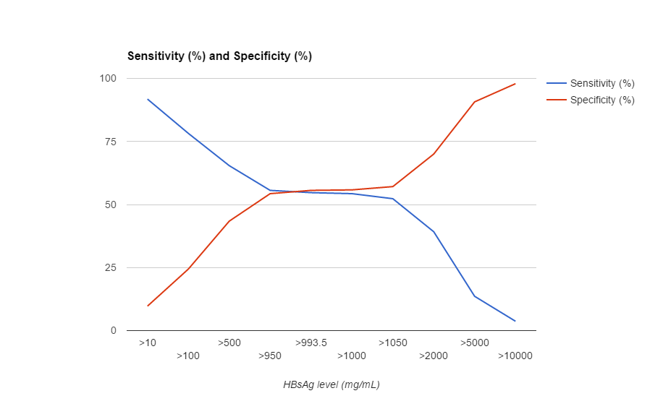
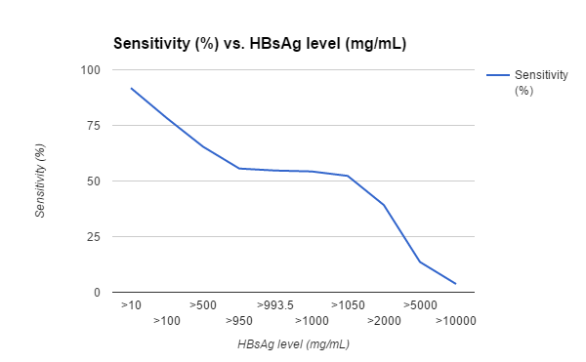

Slide 21
Validation method
HbsAg strip can be validated by the formation of control line
If there is no sufficient amount of sample, then there is no formation of color in the control line as well as the test line indication the test is invalid
For bilirubin,
The sensor has to be tested multiple times to check for linearity across the dynamic ranges,detection limit,sample volume requirements,precision(repeatability),accuracy and user performance evaluation.

Slide 22
Potential Shortcomings
There are conditions if the test is not done correctly, it will give false results. This includes false positive and false negative.

Slide 23
Signal Detection and processor
Positive results (quantitative hepatitis B surface antibody [anti-HBs] levels of > or =12.0 mIU/mL) indicate adequate immunity to hepatitis B from past hepatitis B or HBV vaccination. After receiving a primary HBV vaccine series, individuals with anti-HBs levels of 12 mIU/mL or greater are considered protected from hepatitis B in accordance with the CDC guideline.(1)
A negative result (quantitative anti-HBs level of <5.0 mIU/mL) indicates a lack of recovery from acute or chronic hepatitis B or inadequate immune response to HBV vaccination. The U.S. Advisory Committee on Immunization Practices does not recommend more than 2 HBV vaccine series in nonresponders.(1)
Indeterminate results (quantitative anti-HBs levels in the range from > or =5 to <12 mIU/mL) indicate inability to determine if anti-HBs is present at levels consistent with recovery or immunity. Repeat testing is recommended in 1 to 3 months.

Slide 24
Reference
Jaundice in Adults-http://www.medicinenet.com/jaundice_in_adults/page3.htm
Hepatitis B- http://www.who.int/mediacentre/factsheets/fs204/en/
Designs, formats and applications of lateral flow assay: A literature review - http://www.sciencedirect.com/science/article/pii/S131961031400129X
Multiple analyte assay device with sample integrity monitoring system-https://www.google.com/patents/US6514769
An integrated electrochemical device based on immunochromatographic test strip and enzyme labels for sensitive detection of disease-related biomarkers-Zhe-Xiang Zoua,b, Jun Wangb, Hua Wangb, Yao-Qun Li a,∗, Yuehe Linb,∗∗
Electrochemical reaction of Bilurubin-http://www.google.com/patents/US7749766
Electrochemical sensing in paper-based microfluidic devices-https://gmwgroup.harvard.edu/pubs/pdf/1077.pdf
DesiccantTablets-http://packagingmaterial.jamesdawson.com/item/diagnostic-medical-industries-desiccant/desiccant-tablets/dt
Enzyme-probes-https://www.thermofisher.com/us/en/home/life-science/protein-biology/protein-biology-learning-center/protein-biology-resource-library/pierce-protein-methods/enzyme-probes.html

Slide 25
Reference
10. US 20140273028 A1-http://www.google.com/patents/US20140273028
11. Hepatitis B Surface Antibody, Qualitative/Quantitative, Serum-http://www.mayomedicallaboratories.com/test-catalog/Clinical+and+Interpretive/8254
System and method for reading a test strip-https://www.google.com/patents/EP1952121A2
Devices, methods, and test kits for electronic analyte assaying -https://www.google.com/patents/US20130217136
11. All Graphics designed in Adobe Illustrator, Blender 3D, Excel Charts, Google Analytics.

